Slide 1
Linear regression and fitting time series models
Syndromic Surveillance Training – Day 2

Slide 2
Review of Yesterday
Answer the following questions with a person next to you
What is syndromic surveillance?
What indicators could be used for syndromic surveillance? For healthcare utilization?
Any questions from yesterday?

Slide 3
How can we leverage routinely collected data to improve COVID-19 response?
Syndromic Surveillance
Health Service Utilization
What regional areas have a higher than expected increase in the number of patients with COVID-19-associated symptoms?
How do the number of individuals receiving care during the COVID-19 pandemic compare to what is expected?
The methods for routine monitoring will involve identifying “deviations” from what is expected for further investigation.
Notes:
There are TWO goals of this activity.
The first goal is to assessing the direct impact of COVID19 through syndromic surveillance. This involves using data on symptoms or outcome directly related to COVID-19 to flag geographic areas for potential COVID-19 circulation. This does not use information on positive COVID-19 tests, but instead uses information on symptoms, such as pneumonia or flu-like symptoms, to identify hotspots.
The second goal is to quantify the indirect impacts of COVID19 on utilization of essential health services, which range from assessing changes in the number of outpatient visits to the number babies delivered in a health facility to the number of children receiving their immunizations.
Despite being two distinct goals, these goals do share the fact they BOTH use routinely collected data and look for deviations from what is “expected”. And so, the data science tools that we use will be similar.

Slide 4
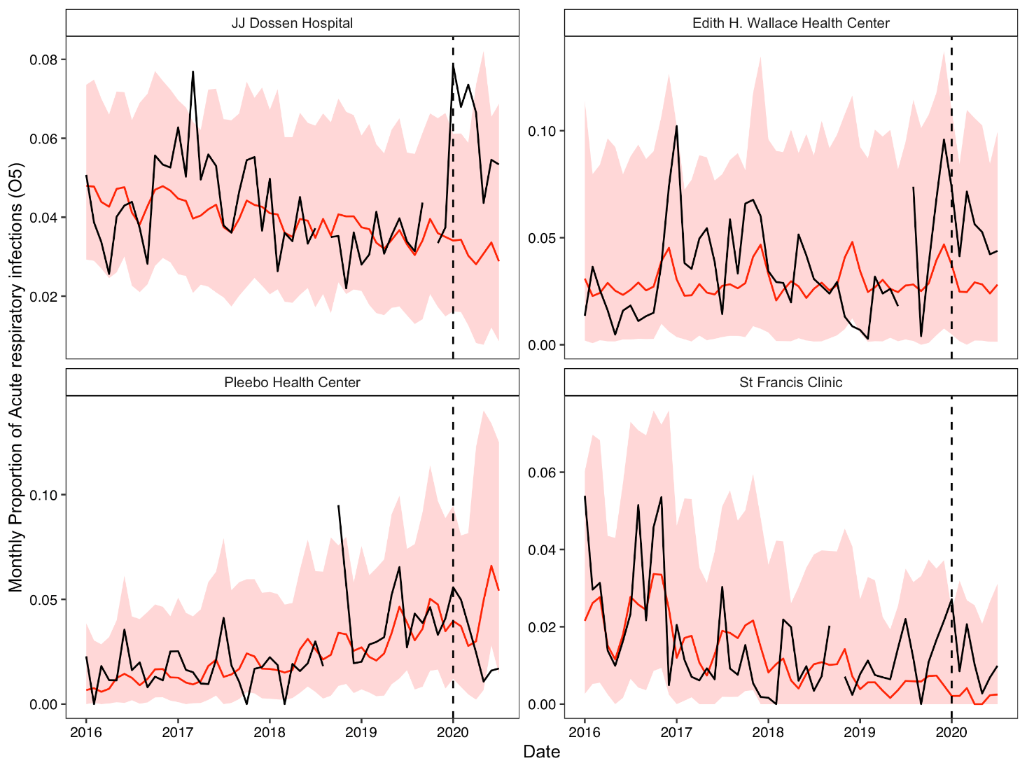
COVID-19 syndromic surveillance
Using ARI

Slide 5
Teaching Objectives
Introduce linear regression
Describe time series modeling
Learn about key strategies
Plotting
Time trends
Seasonality
Discuss two examples

Slide 6
Review of coding from yesterday
What do we call a data object in R?
What is an R “function”?
From yesterday, name as many R functions as you can and what they do.

Slide 7
Review of coding from yesterday
What do we call a data object in R?
What is an R “function”?
From yesterday, name as many R functions as you can and what they do.
library()
readRDS()
read_csv()
head()
View()
str()
%>%
filter()

Slide 8
Linear Regression

Slide 9
Demonstration: https://medium.com/swlh/visualising-linear-regression-dfac98624d27
Interactive tutorial: https://tinyurl.com/562azyab

Slide 10
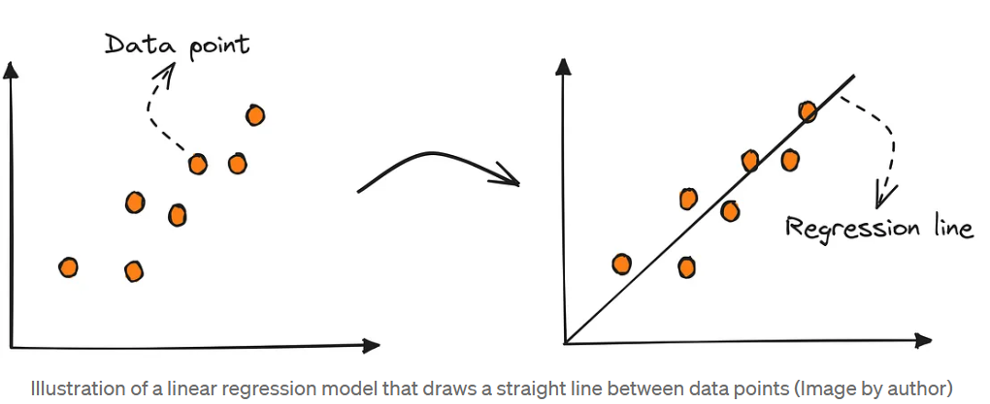
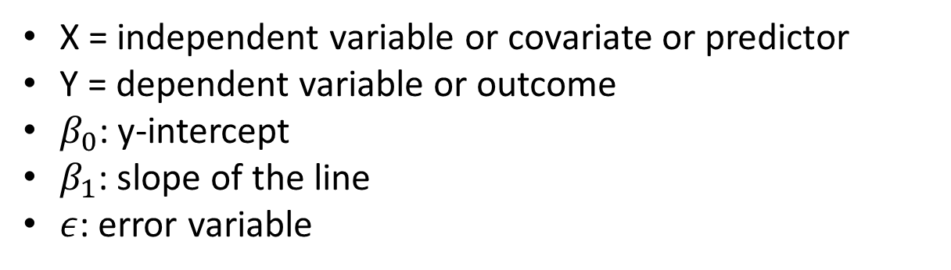
Simple Linear Regression
X = independent variable or covariate or predictor
Y = dependent variable or outcome
$β_{0}$: y-intercept
$β_{1}$: slope of the line
$ε$: error variable
https://pub.towardsai.net/machine-learning-the-first-step-is-to-understand-simple-linear-regression-30dde8b4739

Slide 11
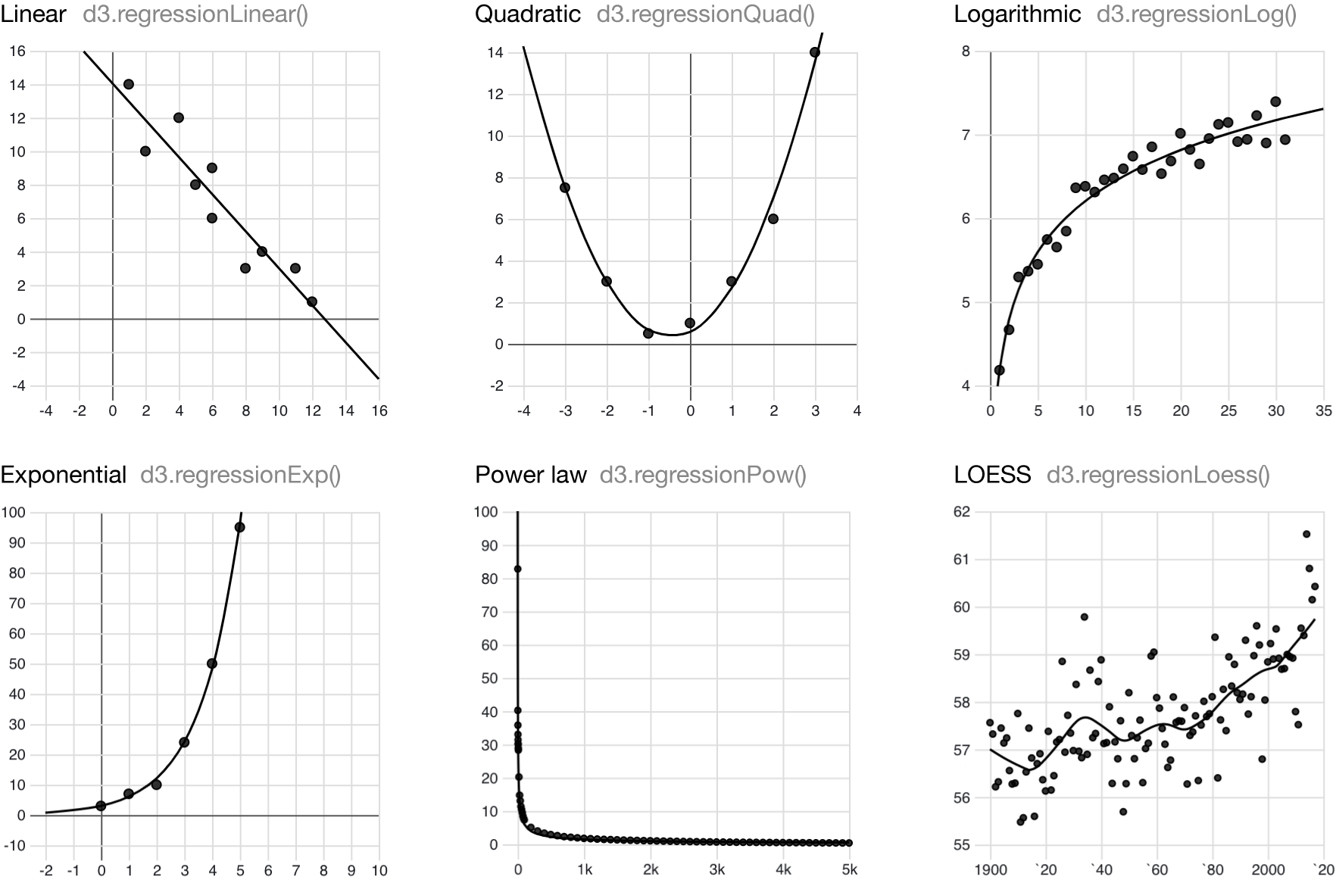
What is linear regression?
Goal: Study relationship between two variables X and Y
Regression: Studying relationship between X and Y to predict Y.

Slide 12
Part 2 - What is a time series?

Slide 13
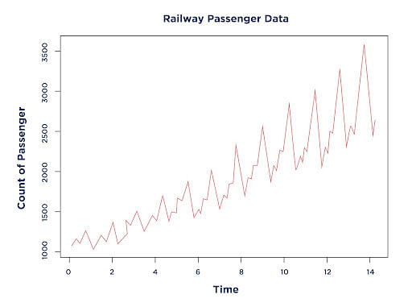
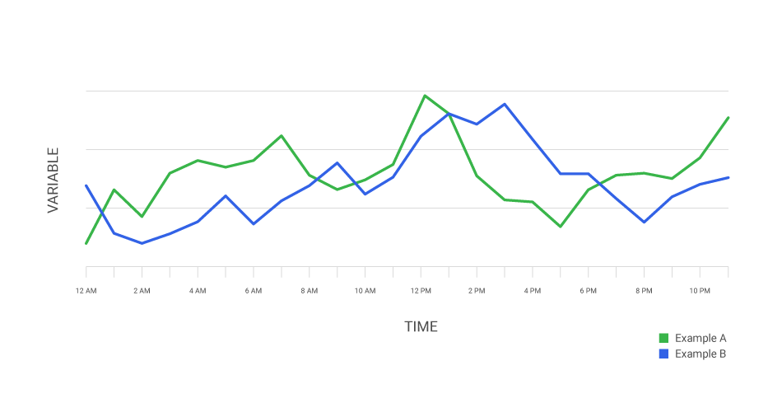
What is a time series?

Slide 14
Steps we will cover
Setup data
Visually inspect the data
Perform preliminary analysis
Run the final model and plot the results

Slide 15
Step 1: Setup Data

Slide 16
Data Setup
One data row for each time period, including:
Time variable for day/month/year
Outcome of interest at that time period
Notes:
Doing the basic setup for population-level data. Can also use individual data with a similar set of variables (1 line for each observation at each time period)
While you can do this in R, it’s easier in Excel

Slide 17
Month | Visits
2016-01-01 | 557
2016-02-01 | 574
2016-03-01 | 542
2016-04-01 | 793
2016-05-01 | 605
2016-06-01 | 612
2016-07-01 | 685
2016-08-01 | 466
2016-09-01 | 554
2016-10-01 | 698
… | …
Notes:
Average monthly water flow over the year in cubic metres per second

Slide 18
Step 2: Visually Inspect Data

Slide 19
Visually Inspect Data
What you are looking for:
Trends
Linear
Polynomial
Exponential
Seasonal
Potential interventions
Data quality issues
Missing data
“Wild” points

Slide 20
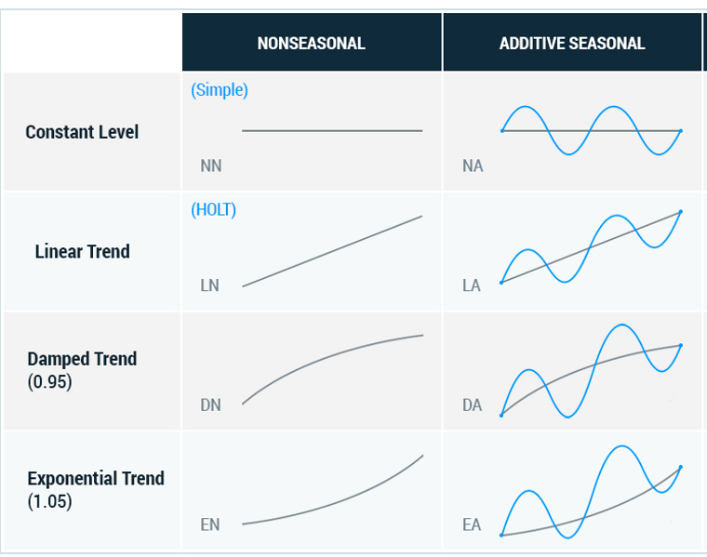

Slide 21
What trends do we see here?
Notes:
Measured water flow in 10^8 cubic metres
Point near 1913 was a recognized drought year

Slide 22
Step 3: Preliminary Analysis

Slide 23
Where we are now
Setup data
Visually inspect the data
Preliminary analysis
Check for and address autocorrelation
Run the final model and plot the results

Slide 24
Preliminary analysis
Run a standard OLS regression with a time series specification
We will work through:
Intercept-only
Simple time trend
Quadratic time trend
Next, we will add in seasonality

Slide 25
Intercept-only Model
outcome_{t} =β₀+ε_{t}
Notes:
B0: expected outcome at first time point
B1: pre-existing trend in the outcome of interest
B2: immediate change in the level of the outcome after the intervention (first var of interest)
B3: change in the trend of the outcome following intervention (second var of interest)

Slide 26
# Run a linear model with only an intercept term
ols.model <- lm(count ~ 1, data=dataset)
# Different functions to work with the model
# Print a summary of the results
summary(ols.model)
# Produce confidence intervals
confint(ols.model)

Slide 27
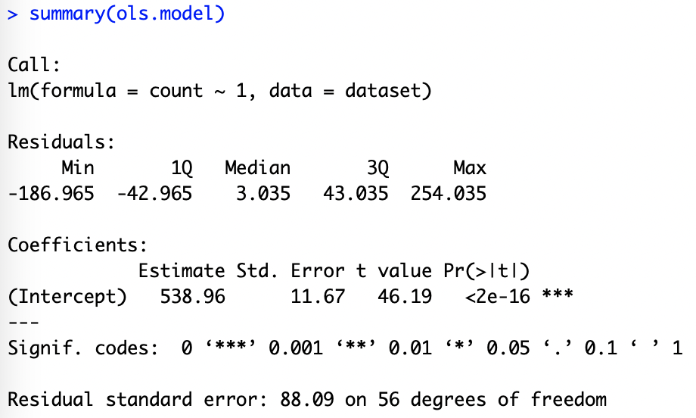

Slide 28
# Input dataset and x,y axis variables
ggplot(dataset,aes(x=time,y=count)) +
# Add points
geom_point(color="pink") +
# Add fitted line
geom_line(aes(x=time,y=ols.model$fitted.values),color="red") +
# Change figure aesthetics
xlab("Month") +
ylab("Number of Outpatient Visits") +
ylim(c(0,900)) +
theme_bw()

Slide 30
Intercept and Time Model
outcome_{t} =β₀+ε_{t}
outcome_{t} =β₀+ β₁·time+ε_{t}
Notes:
B0: expected outcome at first time point
B1: pre-existing trend in the outcome of interest
B2: immediate change in the level of the outcome after the intervention (first var of interest)
B3: change in the trend of the outcome following intervention (second var of interest)

Slide 31
# Run a linear model with an intercept term and time term
ols.model.time <- lm(count ~ time, data=dataset)
# Different functions to work with the model
# Print a summary of the results
summary(ols.model.time)
# Produce confidence intervals
confint(ols.model.time)

Slide 32
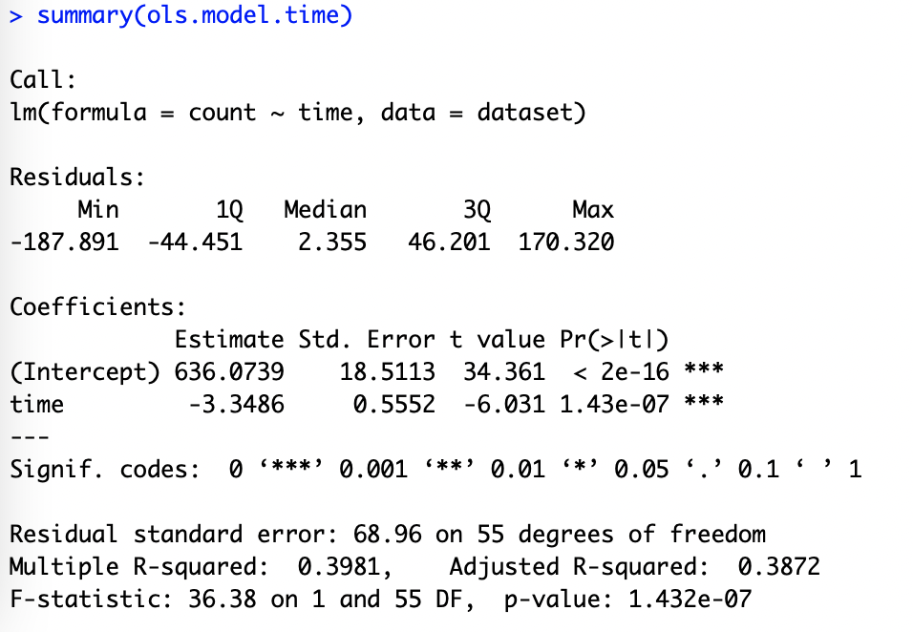

Slide 34
Intercept and Time Model
outcome_{t} =β₀+ε_{t}
outcome_{t} =β₀+ β₁·time+ε_{t}
outcome_{t} =β₀+ β₁·time+β₂·time²+ε_{t}
Notes:
B0: expected outcome at first time point
B1: pre-existing trend in the outcome of interest
B2: immediate change in the level of the outcome after the intervention (first var of interest)
B3: change in the trend of the outcome following intervention (second var of interest)

Slide 35
# Run a linear model with an intercept term and square term
ols.model.time2 <- lm(count ~ time + I(time^2), data=dataset)
# Different functions to work with the model
# Print a summary of the results
summary(ols.model.time2)
# Produce confidence intervals
confint(ols.model.time2)

Slide 36
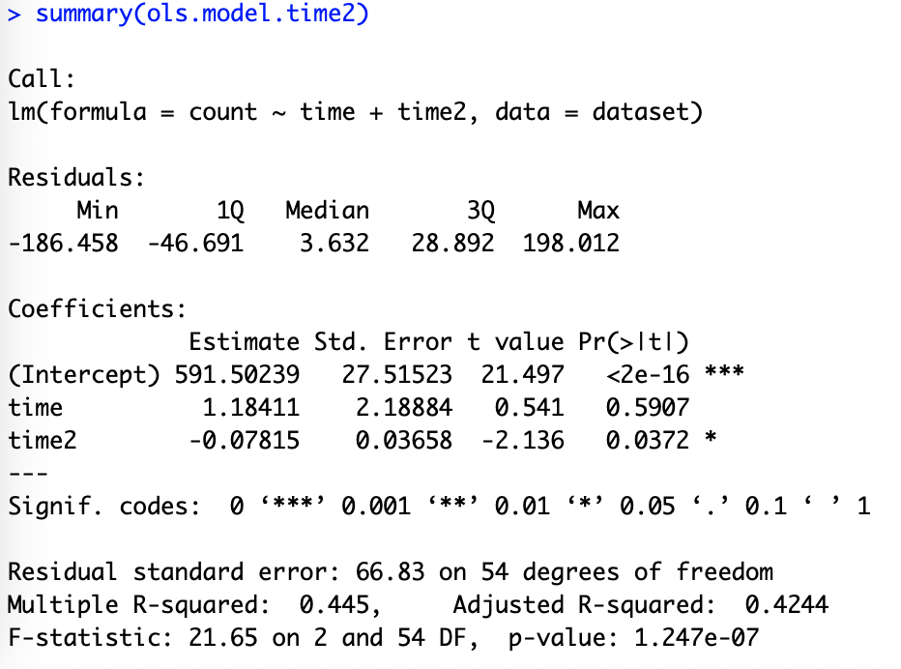

Slide 38
Part 3 - Seasonality and time trends

Slide 39
Time series patterns
Seasonal: Outcomes are impacted by seasonal factors (season, month, day of the week)
Fixed with known frequency
Easily mistaken with fluctuations (must be related to some aspect of calendar time)
Trend: Long-term increase or decrease in the data.
Trends can change direction over time
Trends do not need to be linear
Source: Forecasting: Principles and Practice (https://otexts.com/fpp2/)

Slide 40
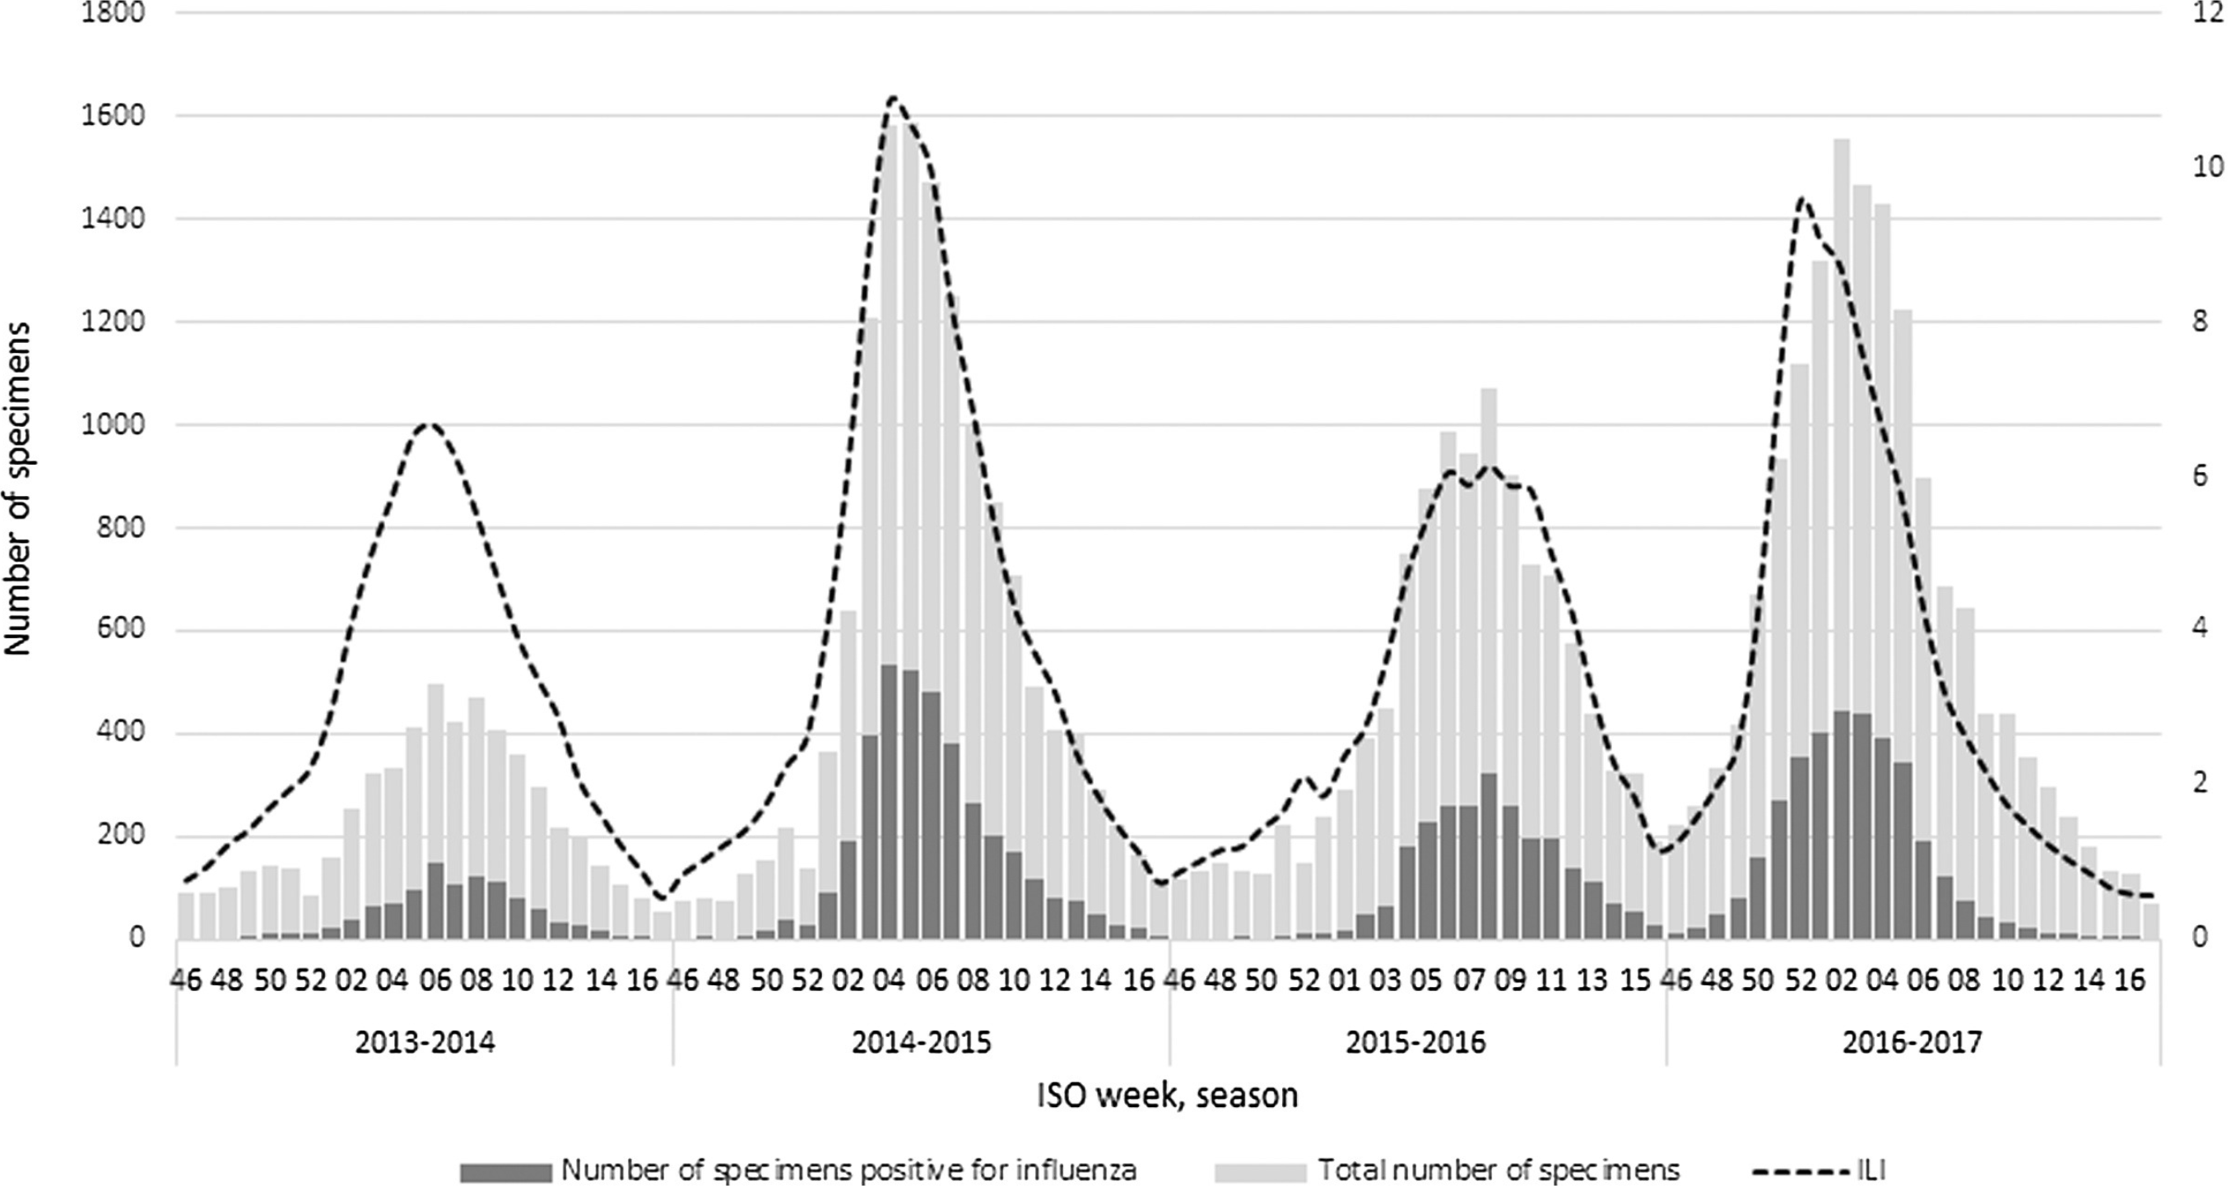
Influenza in Italy
(Rosano et al., 2019)
Notes:
End of January through March (Winter months) and decreases in the cold months.

Slide 41
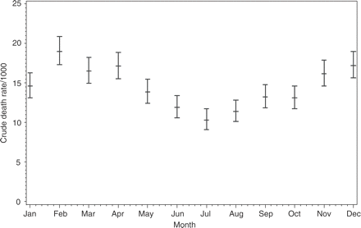
Death rates in Burkina Faso from 1993-2001
(Kynast-Wolf et al., 2005)

Slide 42
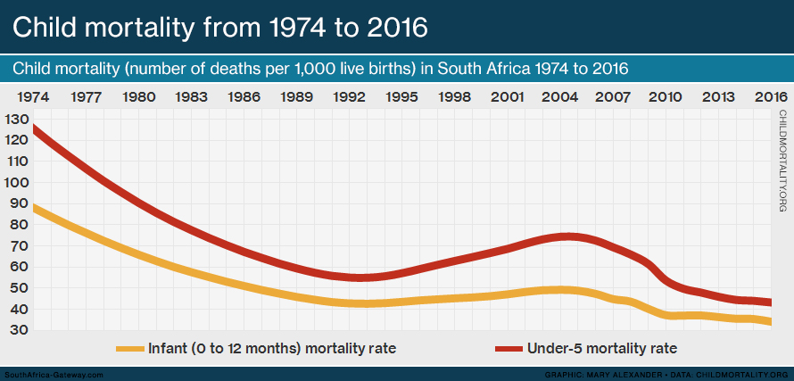
Notes:
Sometimes we will refer to a trend as “changing direction,” when it might go from an increasing trend to a decreasing trend.

Slide 43
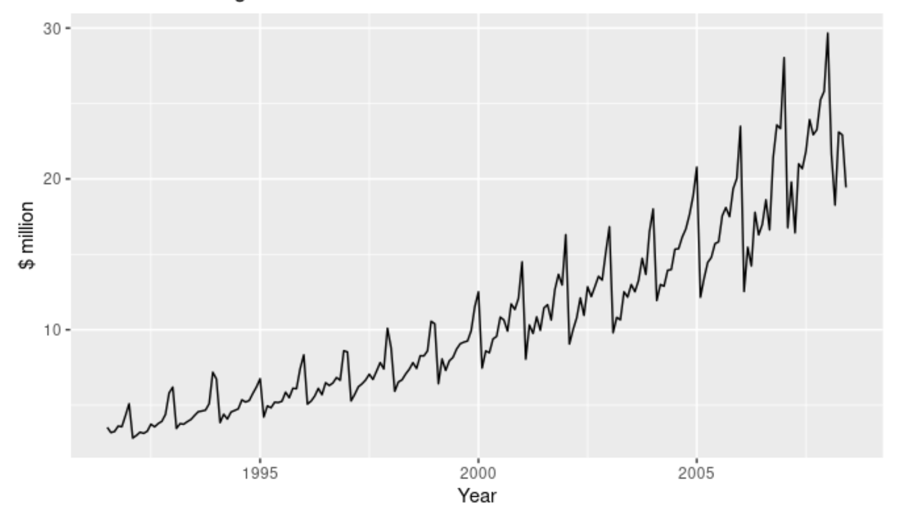
Antidiabetic drug sales in Australia
Source: Forecasting: Principles and Practice (https://otexts.com/fpp2/)
Notes:
There is also a strong seasonal pattern that increases in size as the level of the series increases. The sudden drop at the start of each year is caused by a government subsidisation scheme that makes it cost-effective for patients to stockpile drugs at the end of the calendar year.

Slide 44
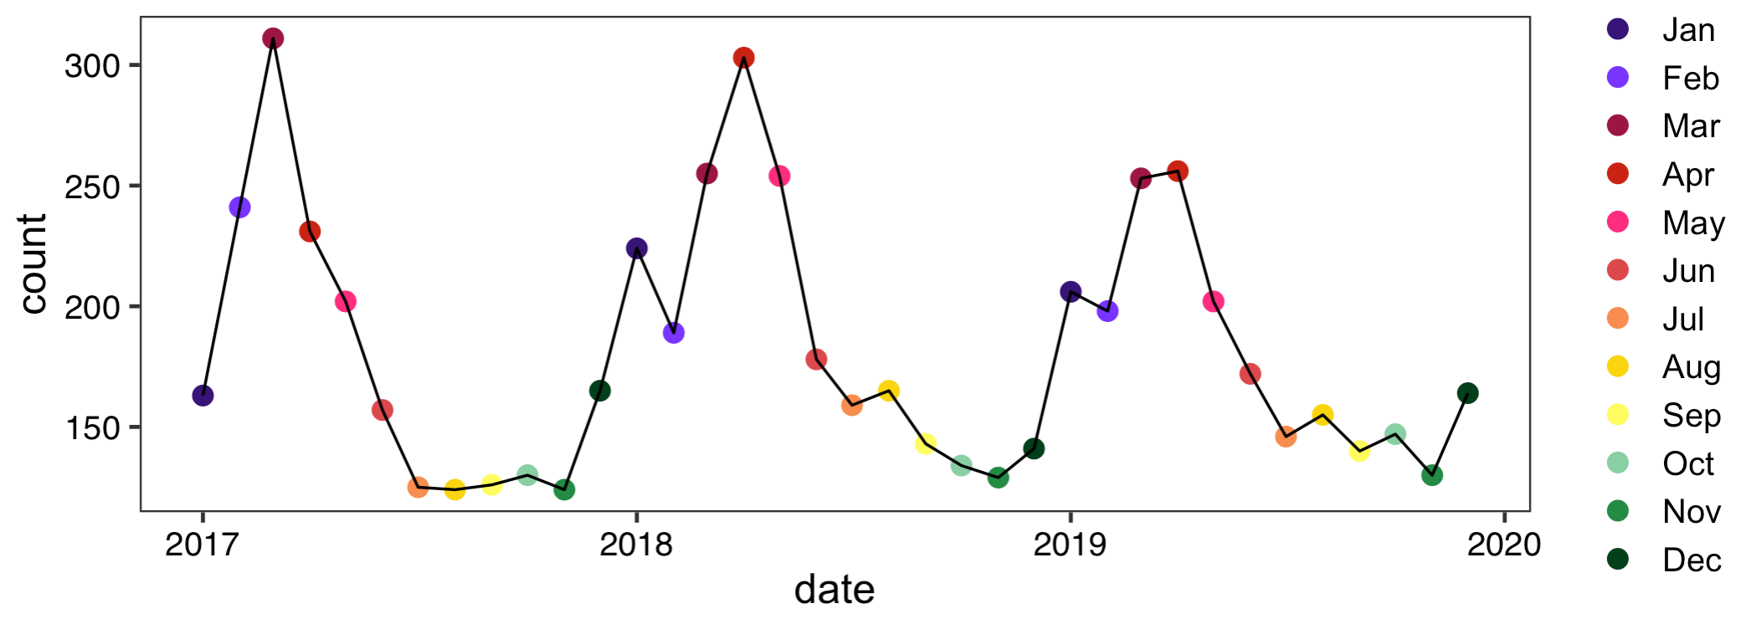
Activity: Malaria cases in Malawi facility

Slide 45
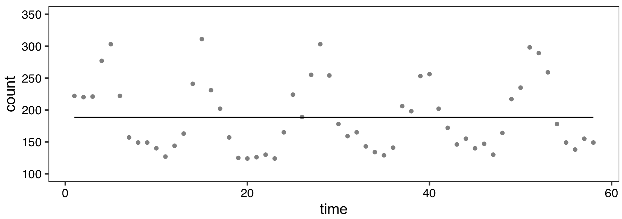
Malaria cases in Malawi facility
outcome_{t} =β₀+ε_{t}

Slide 46
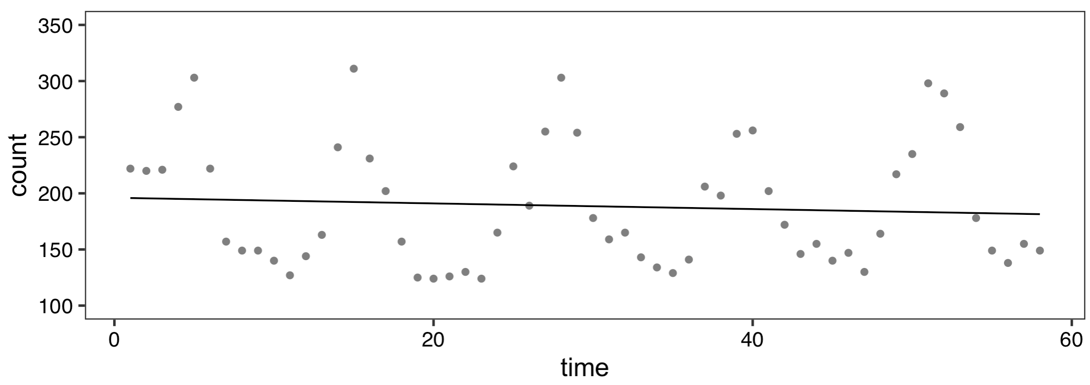
Malaria cases in Malawi facility
outcome_{t} =β₀+ β₁·time+ε_{t}

Slide 47
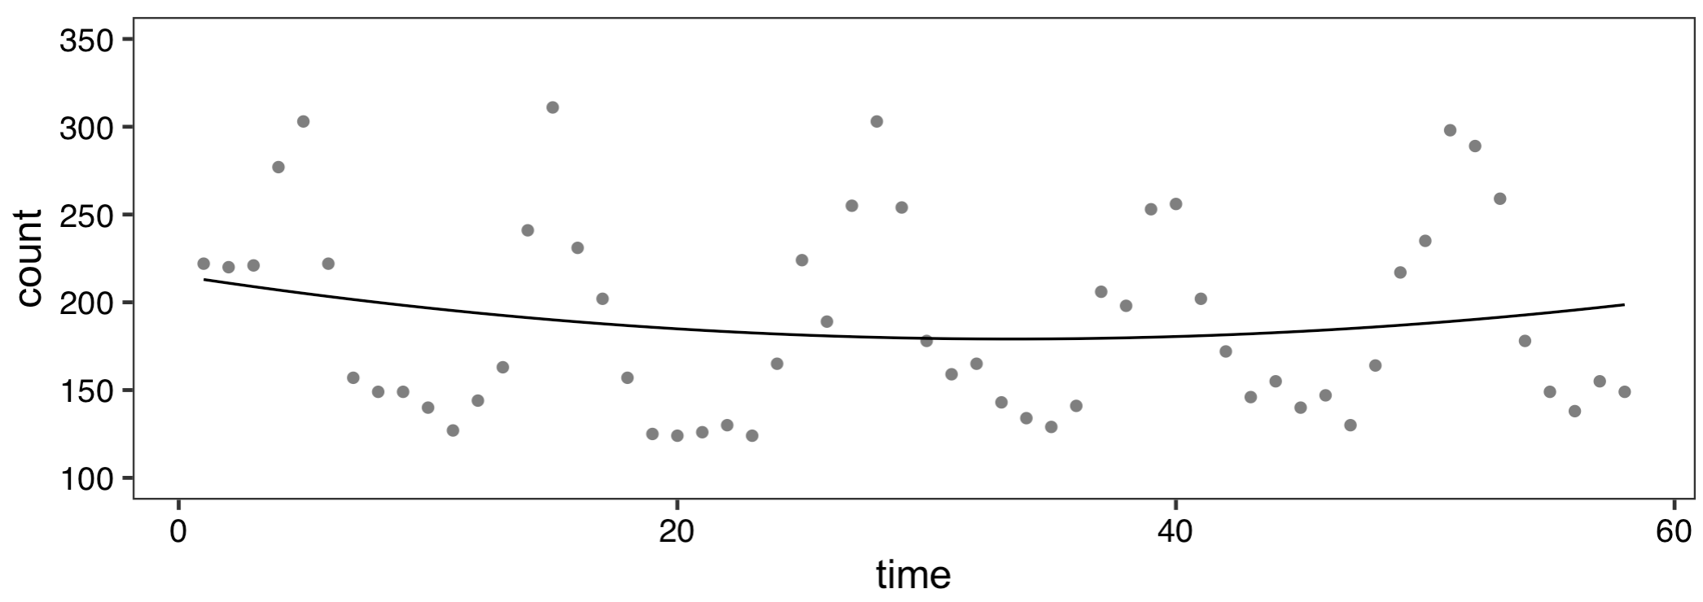
Malaria cases in Malawi facility
outcome_{t} =β₀+ β₁·time+β₂·time²+ε_{t}

Slide 48
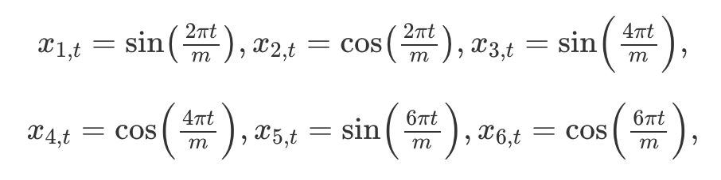
How to deal with seasonality and trend?
Seasonality: Fourier series are popular ways to deal with seasonality in time series models (other options: splines, dummy variables, etc.)
Trends: Add a linear term(s) to capture yearly trend
Will only capture linear decreases or increases over time
If changes are not linear, dummy variables or more complex transformations (log, quadratic, etc.) can be used
Source: Forecasting: Principles and Practice (https://otexts.com/fpp2/)

Slide 49
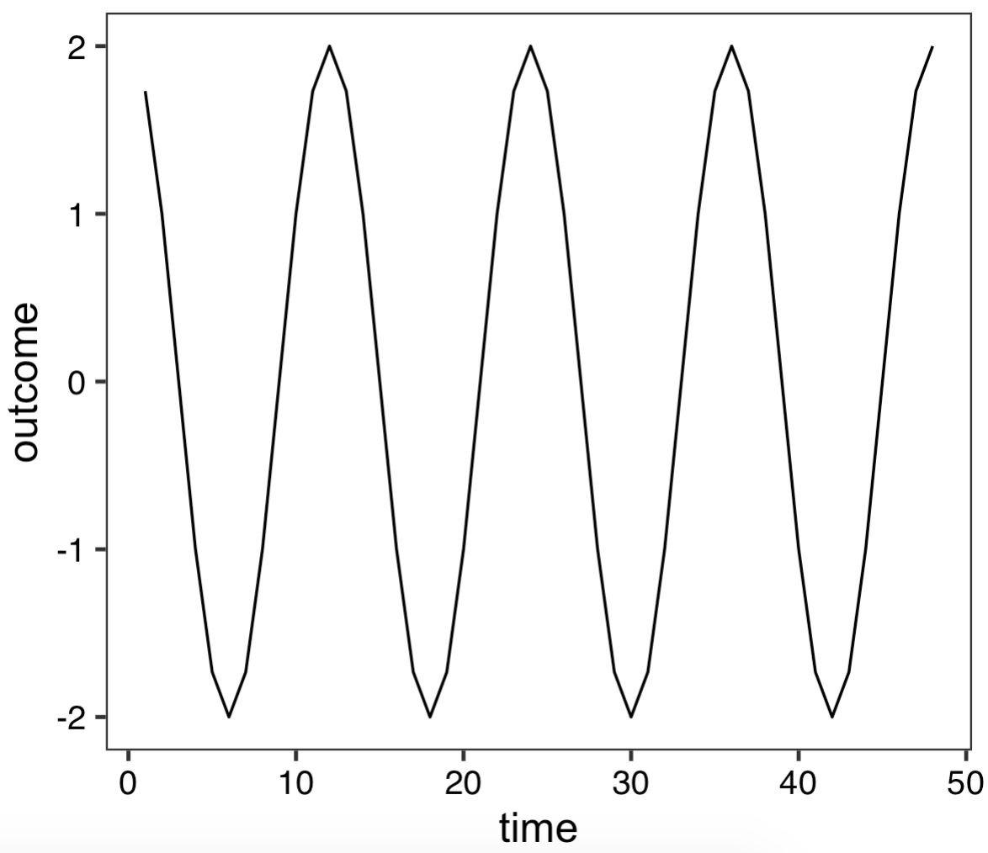
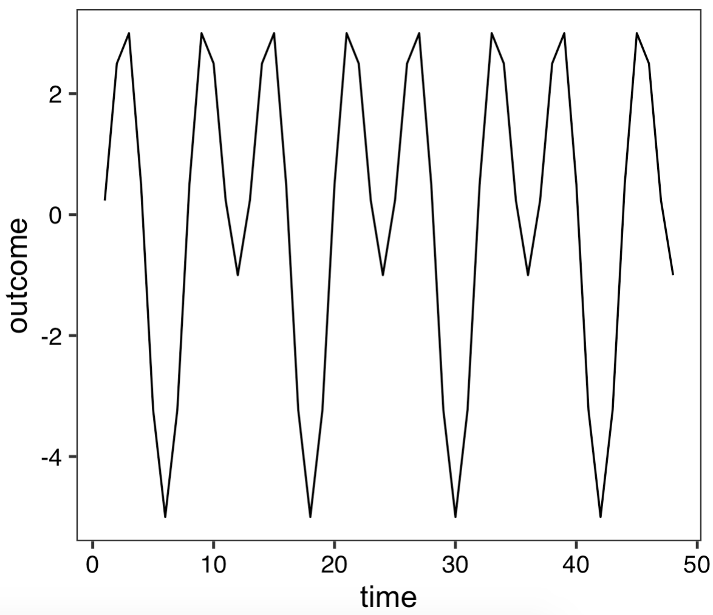
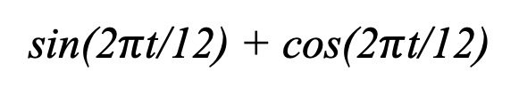
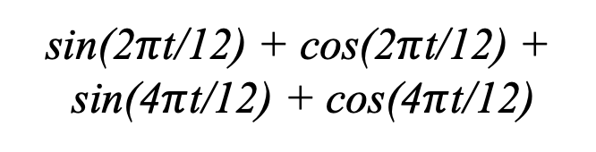
Fourier series (examples)
sin(2$π$t/12) + cos(2$π$t/12) +
sin(4$π$t/12) + cos(4$π$t/12)
sin(2$π$t/12) + cos(2$π$t/12)

Slide 50
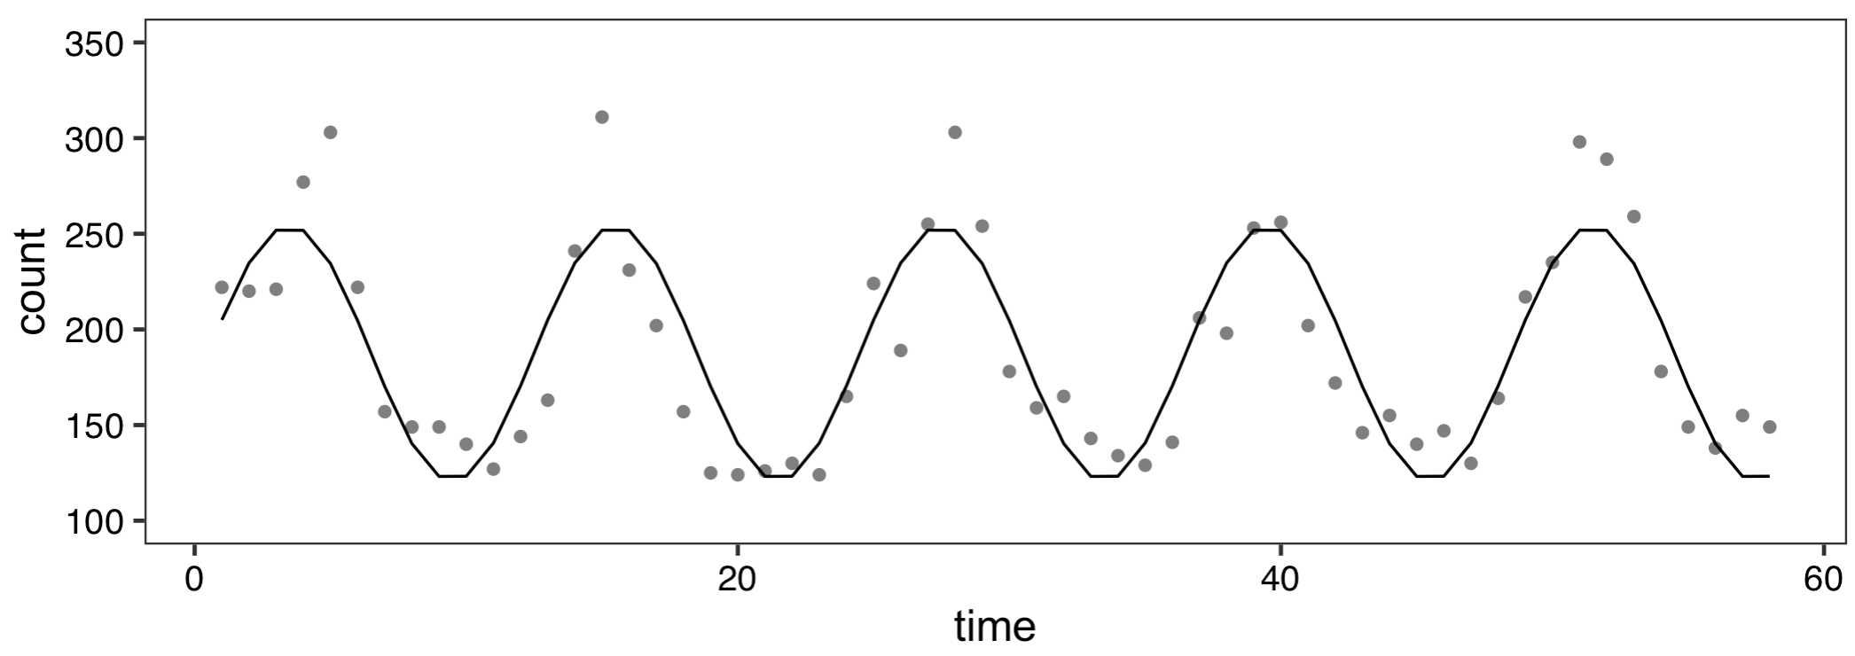
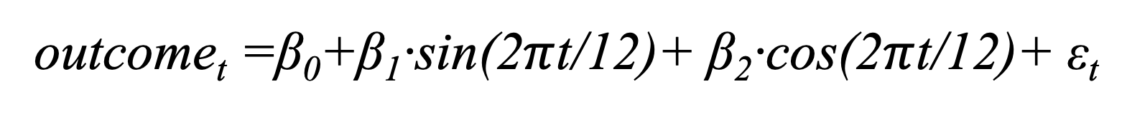
Malaria cases in Malawi facility
outcome_{t} =β₀+β₁·sin(2$π$t/12)+ β₂·cos(2$π$t/12)+ ε_{t}

Slide 51
Extra Slides

Slide 52
Step 4: Autocorrelation

Slide 53
What is autocorrelation?
Relationship in data points over time
Means the data points are not independent
Two types we will discuss:
Autoregression
Moving Average

Slide 54
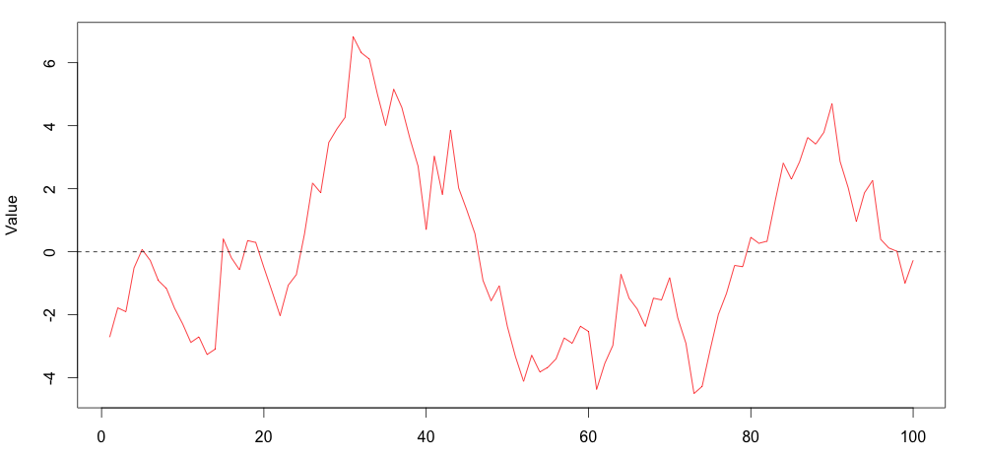
Autoregression
Notes:
Autoregressive (1)
Phi is the parameter, upsilon represents remaining error term
Regression error of each point is related to the one before it

Slide 55
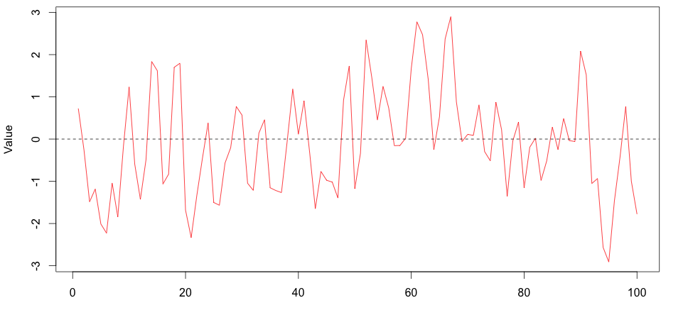
Moving Average
Notes:
Moving Average (1)
upsilon represents error term and previous error term, theta is relationship
Size of the random shock is related to the one before it

Slide 56
Methods to Check Autocorrelation
Several methods, including:
Durbin-Watson test
Residual plots
ACF and partial-ACF plots

Slide 57
Durbin-Watson test
A formal test that tests for correlated residuals
Interpretation
Values of 2 indicate no autocorrelation
lower values indicate positive correlation, higher indicates negative correlation
# Durbin-watson test, 8 time periods
dwt(ols.model.time2,max.lag=8,alternative="two.sided")

Slide 58
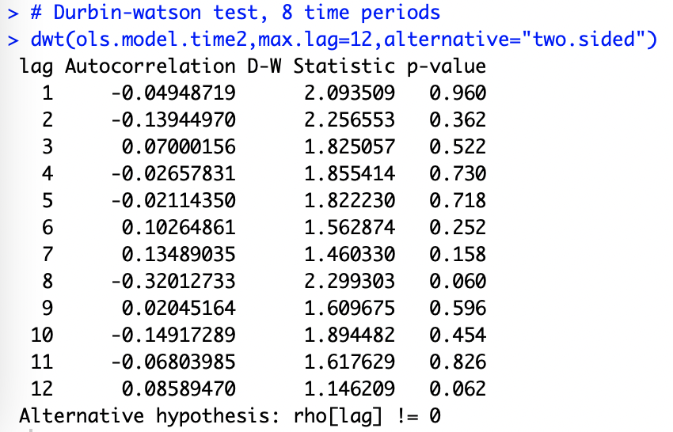

Slide 59
Residual plot
Use a residual plot to visually inspect for independence
ggplot(dataset,aes(x=time,y=ols.model.time2$residuals)) +
# Add points
geom_point(color="red") +
# Add fitted line
geom_line(color="red") +
# Add horizontal line through zero
geom_hline(yintercept=0,linetype="dashed") +
# Change figure aesthetics
xlab("Time") +
ylab("OLS Residuals") +
theme_bw()

Slide 61
Autocorrelation plots
A plotting method with which you can assess autocorrelation and moving averages
Two plots
Autocorrelation
Partial autocorrelation
Notes:
ACF: correlation of a variable with itself over time
PACF: correlation of a variable with itself after removing linear dependance

Slide 62
Model | ACF | Partial ACF
No autocorrelation | All zeros | All zeros
Autoregressive (p) | Exponential Decay | p significant lags before dropping to zero
Moving Average (q) | q significant lags before dropping to zero | Exponential Decay
Both (p,q) | Decay after q^{th} lag | Decay after p^{th} lag

Slide 63
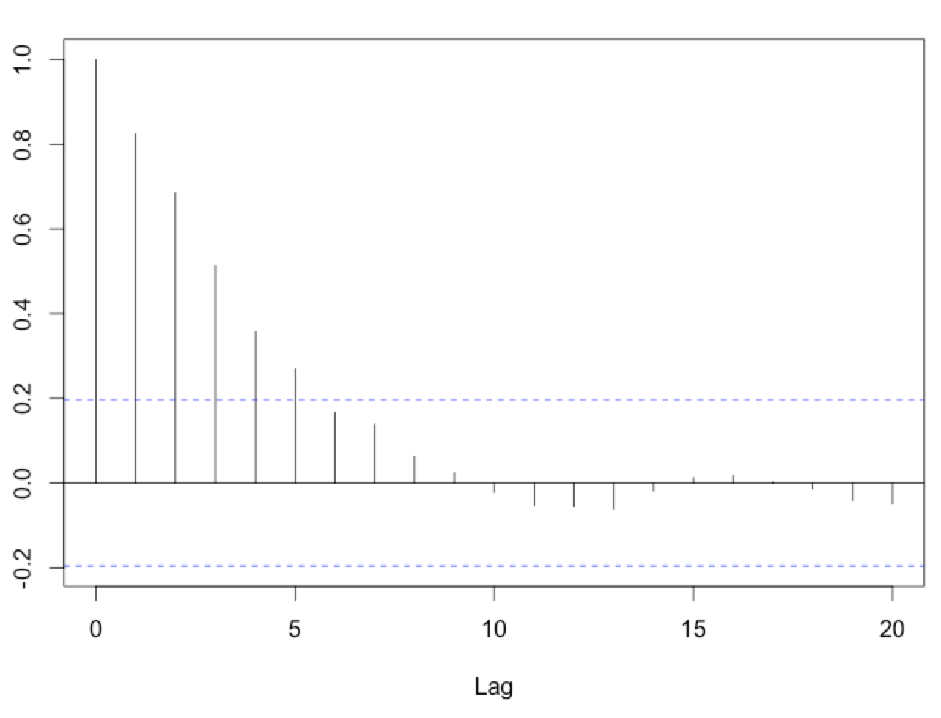
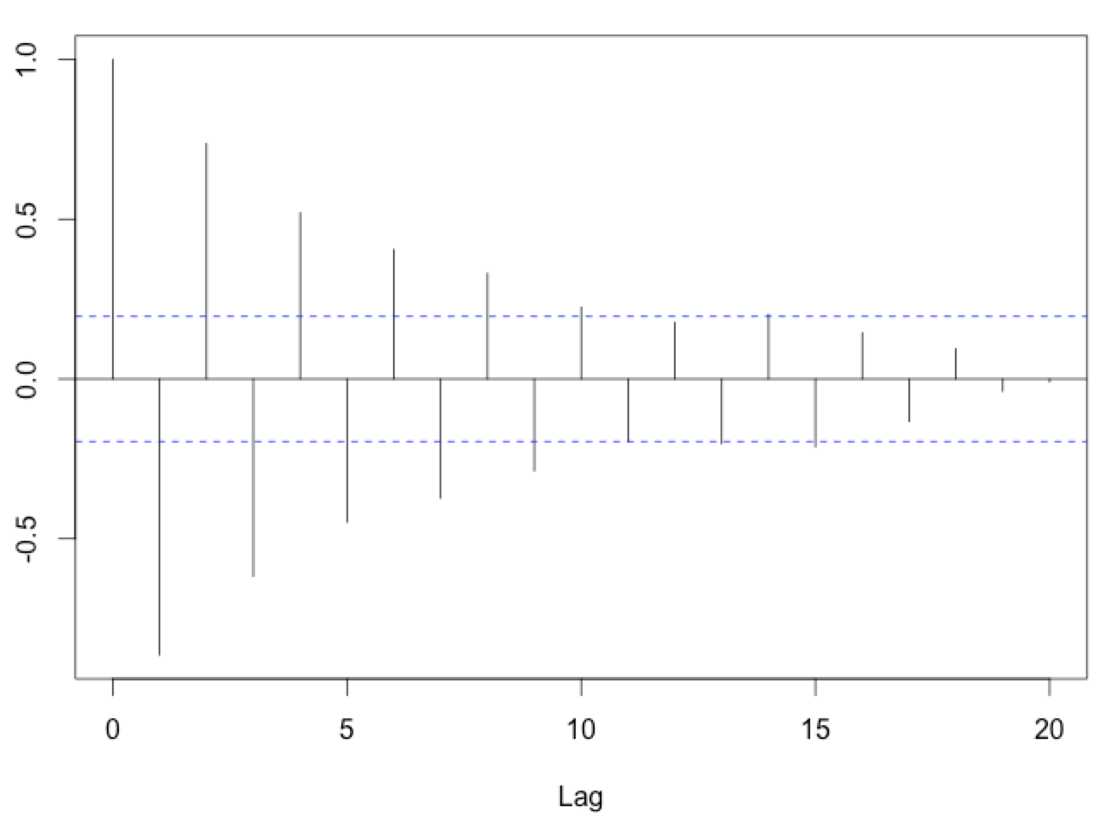
Examples of Exponential Decay

Slide 64
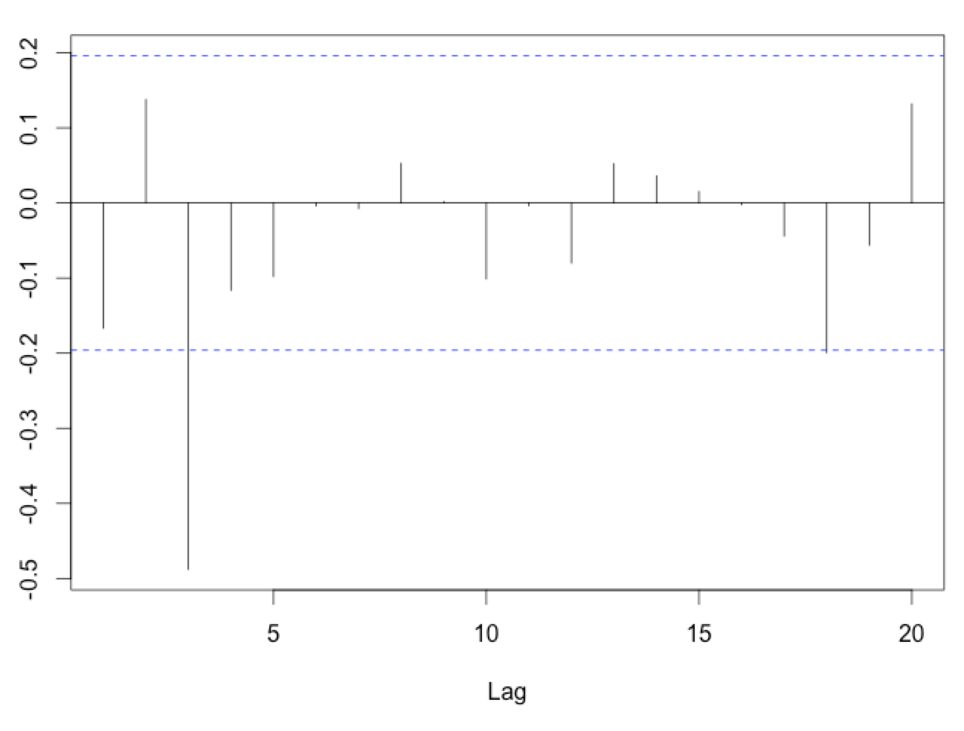
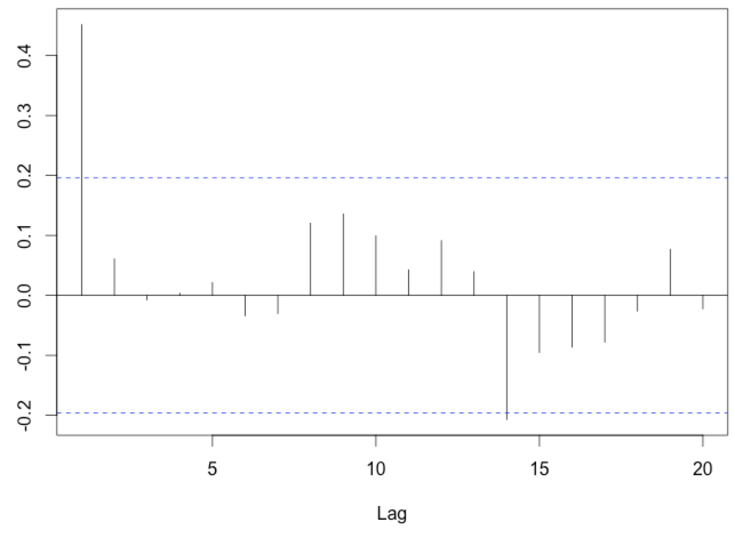
Examples of Significant Lags

Slide 65
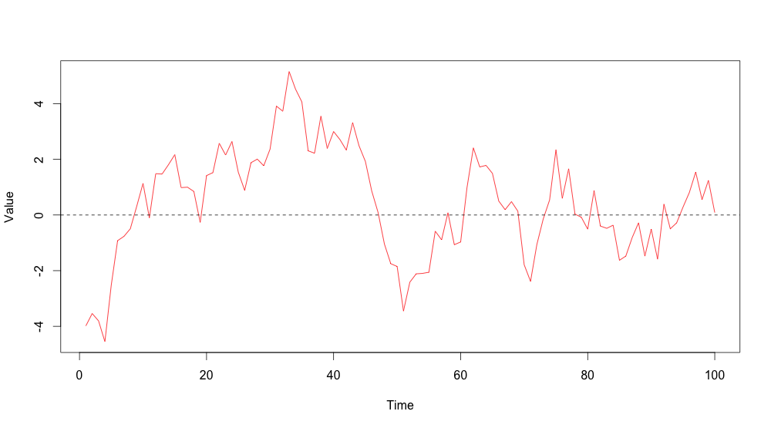
Notes:
Autoregressive (1)
Phi is the parameter, upsilon represents remaining error term

Slide 66
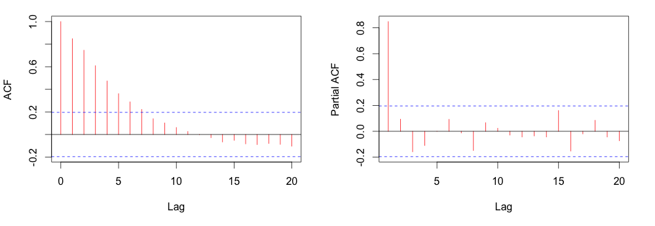
Notes:
Exponential decay on ACF, spike at 1 on PACF
Conclude AR(1) process for modeling

Slide 67
Model | ACF | Partial ACF
No autocorrelation | All zeros | All zeros
Autoregressive (p) | Exponential Decay | p significant lags before dropping to zero
Moving Average (q) | q significant lags before dropping to zero | Exponential Decay
Both (p,q) | Decay after q^{th} lag | Decay after p^{th} lag

Slide 68
Producing ACF/PACF plots
# Plot ACF and PACF
# Set plotting to two records on one page
par(mfrow=c(1,2))
# Produce plots
acf(residuals(ols.model.time2),main="ACF")
acf(residuals(ols.model.time2),type='partial',main="PACF")
# Reset the plotting
par(mfrow=c(1,1))

Slide 69
Notes:
Note the 8 on the right—consistent with the DWT

Slide 70
Step 5: Run the Final Model

Slide 71
Where we are now
Setup data
Visually inspect the data
Preliminary analysis
Check for and address autocorrelation
Run the final model and plot the results

Slide 72
Running the final model
Use function gls (similar specification to lm)
If we wanted to use AR(1), for example:
# Fit the GLS regression model with AR(1)
model_final <- gls(count ~ time + time2,
data=dataset,
correlation=corARMA(p=1,form=~time),
method="ML")
summary(model_final)

Slide 73
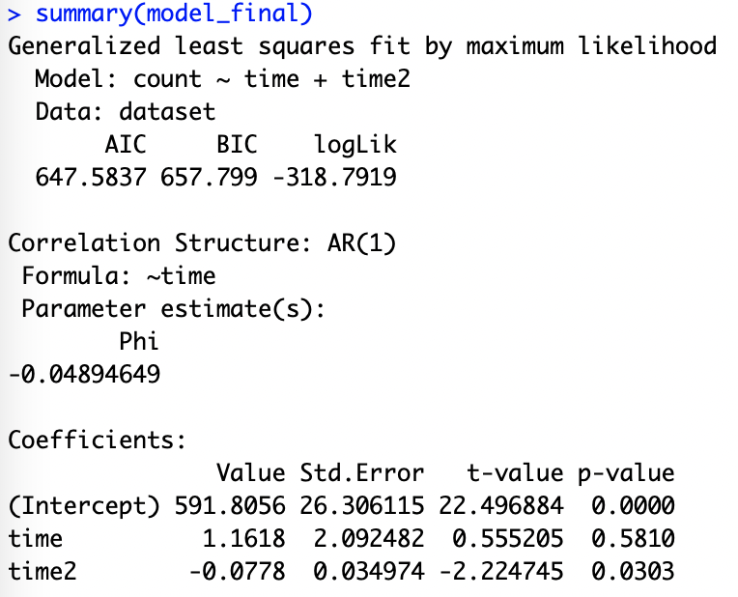

Slide 75
Next week...
Seasonality
Predictions
Syndromic surveillance models

